Slide 1
3 July 2013
Marine Awareness & Prevention Integrated Training
(MAPIT) Implementation Plan

Slide 2
Marine Awareness & Prevention Integrated Training (MAPIT) Goals
Marine Awareness & Prevention Integrated Training (MAPIT) is designed to increase the readiness of individuals and units to achieve the Marine Corps mission, particularly regarding unit and personal readiness.
MAPIT will reduce required annual training redundancies within the Marine Corps focusing on the areas of Combat and Operational Stress Control, Substance Abuse, Family Advocacy, and Suicide Prevention and Response.

Slide 3
Existing Behavioral Health Program Universal Training
Behavioral Health Branch
Substance Abuse
Suicide Prevention
COSC
FAP
Basic and Prime For Life (Req 1 Hour)
Never Leave A Marine Behind Training
(Req 1.5 to 3.5 Hours)
COSC Principles (Req 1 Hour)
Positive Parenting and Coping with Work and Family Stress
Abuse, Prevention, Treatment, Awareness Training through local SACC
Deployed Cycle Training
E1-E3
NCO
SNCO
Officer
OSCAR

Slide 4
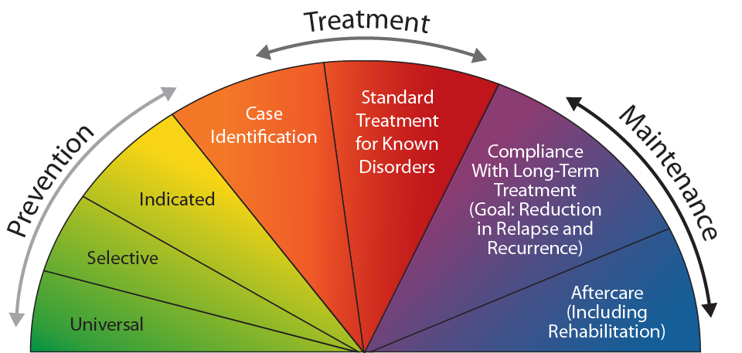
Prevention Continuum
An Evidence Based Framework….
BUMED
USMC and
BUMED
USMC
STRESS CONTINUUM
READY
REACTING
INJURED
ILL

Slide 5
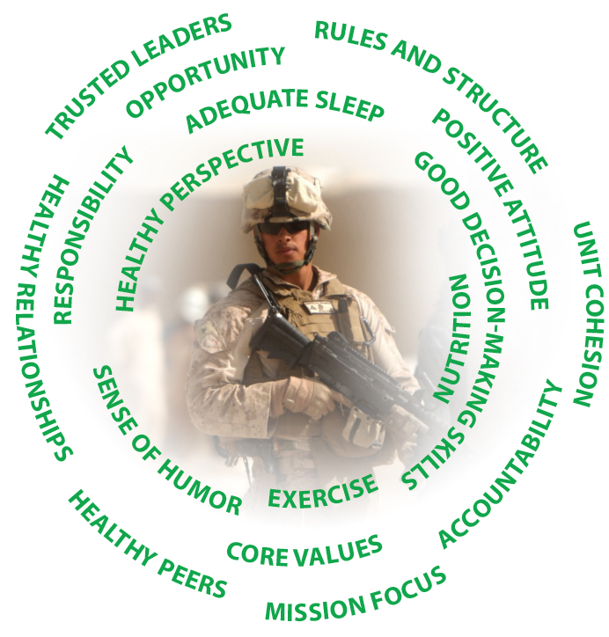
Marine Awareness & Prevention Integrated Training (MAPIT)
Risk & Protective Factors
Warning Signs
Intervention Strategies
Referral and/or reporting
RECOGNIZE
ASK
CARE
ESCORT
Unrestricted
Restricted
Exception to restricted
Definitions
Standard Drink
Current Resources
Peers, Chain of Command, Chaplain, Medical/MCCS, DSTRESS Line
Notes:
(ON SLIDE #10)
f. Even the most motivated and well-trained Marines can find themselves challenged by combat and operational stress. Some Marines can overcome stress-related issues on their own and some will need help. Understand that getting or giving help is aligned with our Corps Value: honor; courage; commitment. It's important to accept help and encourage fellow Marines to seek help because there are potential personal and professional consequences of unmanaged issues. Teamwork is important; it is your responsibility to intervene when a fellow Marine is in distress or making poor decisions.
Many resources are available. The Marine Corps has dozens of programs. Focus on the Big Five resources: your Peers, Chain of Command, Chaplain, Medical/MCCS resources and the DSTRESS Line (1-877-476-7734) can help before issues become overwhelming and direct you to other resources if necessary. When you experience temporary and mild distress, characteristic of the Yellow Zone, engage your peers. Sometimes talking to another Marine is all you need to manage issues and return to the Green Zone. In other cases, your first stop should be your chain of command. Your Corporal, Sergeant or Senior Non-Commissioned Officer (SNCO) will listen to you and can often offer practical advice. Your Chaplain is a great resource, too, especially if you want confidentiality. At the medical clinic or hospital on your installation, you can speak to medical personnel or a counselor for help. If there is a Corpsman attached to your unit, especially if you are deployed, he or she can direct you to the right resources, including self improvement resources available to you through MCCS. Another confidential resource is the DSTRESS line; using this you can speak anonymously with active duty Marines, veteran Marines, licensed counselors and others who understand Marine culture, 24 hours a day. Remember these resources; they can help you find the assistance that’s right for you and your fellow Marines.
It is your responsibility, and part of the commitment you made to the Corps, to be ready to handle whatever the Marine Corps needs of you at any time. You can only do this by being at your best, and sometimes that means asking for and accepting help. It takes courage to ask for help, and doing it at the first signs of a struggle should not hurt your career.
Unmanaged stress affects mind, body, spirit and social fitness. Marines can manage their stress by getting help from the Big Five resources or sometimes talking to another Marine is enough. Someone may think, “If I am diagnosed with a stress illness, such as Post-Traumatic Stress (PTS), anxiety, or depression, it will end my career.” This is false, a stress illness diagnosis, in itself, is not a career-ender. Not getting the help you need can result in behaviors that lead to incidents that can end your career.
Be the Marine you want to be; apply the decision-making process to everyday challenges; utilize your protective factors daily; take care of stress-related issues as they arise; and seek help for you or your fellow Marines when needed. Look out for each other and talk about what’s bothering you as well as ask for help early to maintain our readiness.
Today you learned to make good decisions related to combat and operational stress control, keeping our Corps Values in mind. You’re now able to identify situations when it would be beneficial to seek help. You know why it's important to accept and encourage seeking help for combat and operational stress. You also recognize the potential personal and professional consequences of unmanaged stress.
We talked about protective factors and common sources of stress. You learned that there are Marine Corps resources available to help you with just about any problem, and that your chain of command is a good first-line resource because getting help makes us stronger, especially if we do it before stress becomes overwhelming.

Slide 6
Marine Awareness & Prevention Integrated Training (MAPIT) Modules
MAPIT Entry Level Training (ELT)
MAPIT Continuing Education (CE)
Unit MAPIT (UMAPIT)

Slide 7
Marine Awareness & Prevention Integrated Training (MAPIT) ELT Module
Entry Level Training (ELT):
T&R Event MCCS-BH-1001 - Identify Behavioral Health Matters
Systems Approach to Training (SAT) Compliant
Enlisted Course
Marine Combat Training (MCT)
Replace 135 minutes of existing BH classes
Officer Course
Summer 2013 BHPD developed initiative for OCS/TBS
TBS will include a Naval Academy portion for seniors
Replace existing BH classes

Slide 8
Marine Awareness & Prevention Integrated Training (MAPIT) CE Module
Continuing Education (CE):
T&R Event MCCS-BH-2001 - Conduct Behavioral Health Mentoring
Systems Approach to Training (SAT) Compliant
Enlisted (EPME): 90 minute training conducted at EPME (Advance or Career Course)
Officer (EWS/TBS): 90 minute training conducted at EWS and TBS

Slide 9
Marine Awareness & Prevention Integrated Training (MAPIT) Sustainment
Unit MAPIT (UMAPIT):
Unit Sustainment Course - 90 minute annual training requirement conducted at the unit (Platoon, Squad or Section level)
Will be Included in TECOM’s published annual training requirements bulletin
Will eliminate other annual Behavioral Health “universal” training requirements
MAPIT Dashboard- Integrated prevention strategies to address risk behaviors
Includes outlines for cmdrs located in a central online hub
Included in TECOM’s Commander’s Tool Kit (currently in development)
Briefed at T3 Schools, Cmdr’s Conf and E8 Seminar as a tool/resource
BHPD has lead, but is working with other Behavioral Health Branch SMEs and contractor for specific area application

Slide 10
MAPIT Implementation Plan
MAPIT Entry Level Training (ELT)
MCT: Released to TECOM 7 June 2013
OCS: Release to OCS 15 Aug and TBS 15 Sep 2013
MAPIT Continuing Education (CE)
EWS: Release to EWS 18 July 2013
EPME: Release to EPME 30 July 2013
Unit MAPIT (UMAPIT)
Unit Sustainment Course: FY14 Rollout
MAPIT Dashboard: FY14 Rollout

Slide 11
Marine Awareness & Prevention Integrated Training (MAPIT)
Questions?
POC: Traci Sharpe
Traci.sharpe@usmc.mil
703-432-9239

