Slide 1
ESF 15 Overview and Crisis Communications
FEMA External Affairs
1/15/16

Slide 2
Agenda
FEMA and National Response Framework Overview
Emergency Support Function (ESF) 15: External Affairs Overview
Interagency Coordination
Crisis Communications
ESF 15 Case Study: Typhoon Soudelor response in Saipan

Slide 3
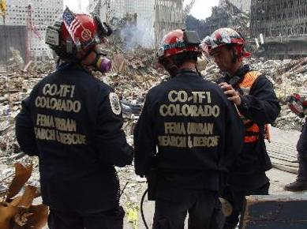
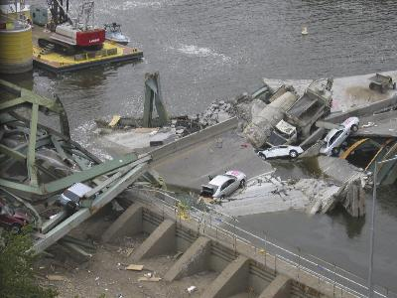
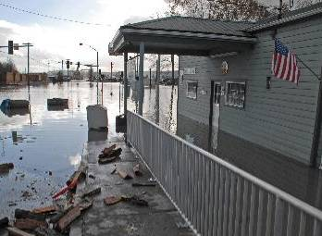
FEMA’s Mission
FEMA’s mission is to support our citizens and first responders to ensure that as a nation we work together to build, sustain, and improve our capability to prepare for, protect against, respond to, recover from, and mitigate all hazards.
Notes:
Don’t read word for word, highlight a few things:
-Work together: whole community effort to prepare for and respond to disasters.
-Five mission areas. Often people think of FEMA as a response agency but want to flag we have programs related to all of these mission areas, such as preparedness grants and the national flood insurance program.
For this presentation, in the interest of time we’ll focus only on response and recovery as it relates to Crisis Communications.

Slide 4
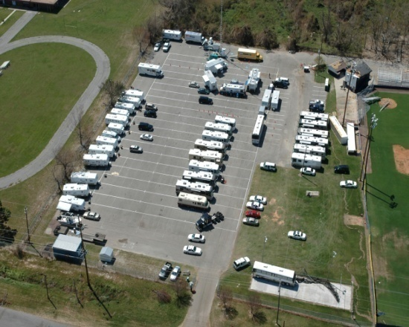
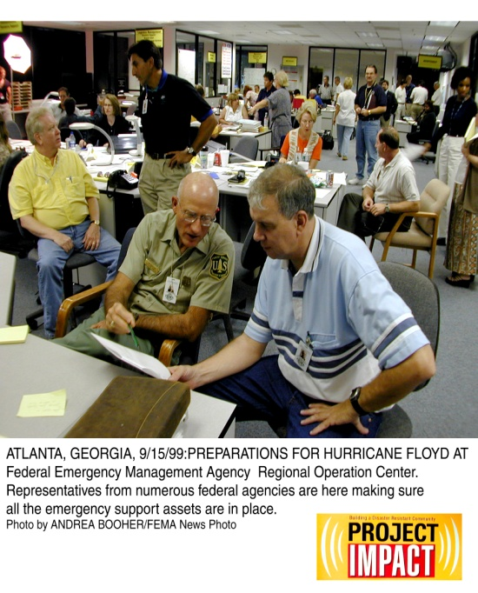
Mission Execution: Response
Plan, manage, coordinate, support and lead federal disaster operations.
Operations Management
Interoperable all-hazards response system
Information Exchange
Field Operations
IMAT/USAR
Coordinate Other Federal Agency operations
Disaster Logistics and Support
Strategically-located warehouses
Prepackaged supplies
Mobile Emergency Response Vehicles

Slide 5
Disaster Declaration Process
Incident
FEMA-State/Tribal
Preliminary Damage Assessment
State must show that the disaster:
-Exceeds state and local capabilities
-Fed assistance is necessary to supplement efforts and available resources
-Governor must have executed the state’s emergency management plan
State/Tribal Declaration Request
FEMA Recommendation
Presidential Declaration
Notes:
Quick overview of Disaster Declaration Process: local government→state support→federal request for assistance. Approved by POTUS, issue major disaster declaration. Open disaster relief funds, trigger to deploy and mission assign.

Slide 6
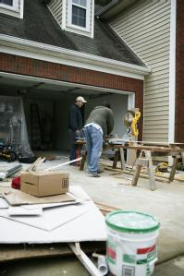
Mission Execution: Recovery
Return individuals and communities to normal function with minimal suffering and disruption of services.
Individual Assistance Program
Public Assistance Program

Slide 7
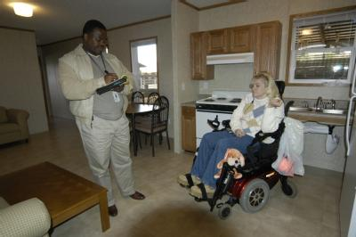
Recovery: Individual Assistance
Temporary housing, home repair, and other needs assistance
Crisis counseling
Disaster-related unemployment assistance
Legal aid
Notes:
When the President declares a disaster and authorizes providing Individual Assistance, FEMA's Individuals and Households Program (IHP) can help homeowners and renters affected by the disaster with housing needs and necessary expenses.
To be considered for IHP housing assistance, the affected home must be the individual's primary residence and it must be located in the disaster area designated for Individual Assistance. To be considered for IHP assistance for necessary expenses or serious needs, the loss must have occurred in the disaster area designated for Individual Assistance. An individual or a pre-disaster member of the household must be a United States citizen, a non-citizen national or a qualified alien.
When a disaster is declared and Individual Assistance is authorized, affected individuals are directed to register with FEMA and to make sure that the information they provide is complete and correct. Once the registration is complete, a copy of the registration/application will be sent to the applicant and if a need is identified, an inspector will be assigned to view the damaged property.
Individuals And Households Program
Housing Assistance
Temporary housing (rent and lodging expense): Money to rent a different place to live or a temporary housing unit, such as a FEMA-provided travel trailer or mobile home, when rental properties are not available.
Repair: Money for homeowners to repair damage from the disaster that is not covered by insurance. The goal is to repair the home to a safe and sanitary living or functioning condition. FEMA may provide up to $5,400 for disasters declared in the 2006 Federal fiscal year. A flood insurance purchase and maintenance requirement may be place on the home if the home is in a Special Flood Hazard Area. NOTE: FEMA's repair assistance will not pay to return a home to its condition before the disaster.
Repairs can include:
Structural parts of a home (foundation, outside walls, roof)
Windows, doors, floors, walls, ceilings, cabinetry
Septic or sewage system
Well or other water system
Heating, ventilating and air-conditioning system
Utilities (electrical, plumbing and gas system)
Entrance and exit ways from the home, including privately owned access roads
Blocking, leveling and anchoring of a mobile home and reconnecting or resetting its sewer, water, electrical and fuel lines and tanks
Replacement: Money is available to homeowners to replace their home destroyed in the disaster that is not covered by insurance. The goal is to help the homeowner with the cost of replacing their destroyed home. A flood insurance purchase and maintenance requirement may be place on the home if the home is in a Special Flood Hazard Area.
Permanent Housing Construction: Money is available for the construction of a home or FEMA will provide direct assistance with the construction. This type of help only occurs in insular areas or remote locations specified by FEMA, where no other type of housing assistance is possible. . Construction shall follow current minimal local building codes and standards where they exist, or minimal acceptable construction industry standards in the area. Construction will aim toward average quality, size and capacity, taking into consideration the needs of the occupant. A flood insurance purchase and maintenance requirement may be place on the home if the home is in a Special Flood Hazard Area.
Other Needs Assistance (ONA)
Money is available for necessary expenses and serious needs caused by the disaster. This includes medical, dental, funeral, personal property, transportation, moving and storage, and other expenses that are authorized by law. Assistance from ONA is cost-shared, between FEMA (75 percent) and the State (25 percent).
An applicant does not apply for ONA, but is referred for assistance based on their ability to secure loan from the U.S. Small Business Administration. If SBA determines that an applicant cannot afford a loan, SBA will automatically refer the applicant back to ONA for additional help.
ONA can be provided for disaster-related serious needs in five categories:
Repair or Replacement of Personal Property: Money may be available to repair or replace items damaged or destroyed as a result of the disaster that are not covered by insurance. FEMA will not pay for all damaged or destroyed personal property. A flood insurance purchase and maintenance requirement may be place on the personal property if the property is in a Special Flood Hazard Area.
Repair and replacement may include:
Clothing
Household items (room furnishings, appliances)
Specialized tools or job-related protective clothing and equipment
Necessary educational materials (such as school books)
Clean-up items (such as wet/dry vacuum, air purifier, dehumidifier)
Transportation: Money to address the cost of repairing and/or replacing a vehicle that is no longer usable because of disaster-related damage. Medical and Dental Expenses: Money to address the cost of medical treatment or the purchase of medical equipment required because of physical injuries received as a result of the disaster. Funeral and Burial Costs: Money to address the cost of funeral services, burial or cremation and other funeral expenses related to a death caused by the disaster. Other Items: The State and FEMA can agree to pay for specific disaster-related costs that are not listed above. Some examples are generators, moving and storage expenses, and the cost of a National Flood Insurance Program Group Flood Insurance Certificate.

Slide 8
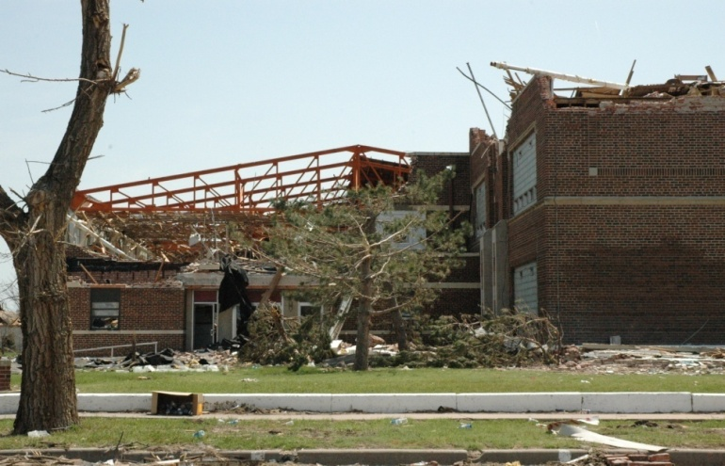
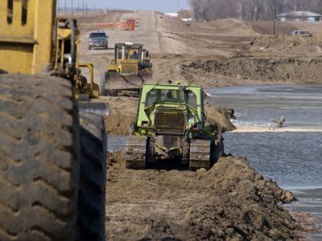
Recovery: Public Assistance
Federal assistance to State or local governments and eligible non-profit organizations
Emergency protective measures and debris removal
Repair, restoration or reconstruction of disaster-damaged public facilities and infrastructure
Notes:
GREENSBURG, KS, HIGH SCHOOL

Slide 9
National Response Framework (NRF)
A guide to how the Nation response to all types of disasters.
Scalable, flexible and adaptive concepts.
Describes principles, roles and responsibilities, and coordinating structures for delivering core capabilities during a response

Slide 10
ESFs – Who Are They?
ESF #1 - Transportation
ESF #2 - Communications
ESF #3 - Public Works and Engineering
ESF #4 - Firefighting
ESF #5 - Emergency Management
ESF #6 - Mass Care, Emergency Assistance, Housing, and Human Services
ESF #7 - Logistics Management and Resource Support
ESF #8 - Public Health and Medical Services
ESF #9 - Search and Rescue
ESF #10 - Oil and Hazardous Materials Response
ESF #11 - Agriculture and Natural Resources
ESF #12 - Energy
ESF #13 - Public Safety and Security
ESF #14 – REMOVED
ESF #15 - External Affairs
Notes:
Point out where each ESF sits…
ESF #1 - Transportation
ESF #2 - Communications
ESF #3 - Public Works and Engineering
ESF #4 - Firefighting
ESF #5 - Emergency Management
ESF #6 - Mass Care, Emergency Assistance, Housing, and Human Services
ESF #7 - Logistics Management and Resource Support
ESF #8 - Public Health and Medical Services
ESF #9 - Search and Rescue
ESF #10 - Oil and Hazardous Materials Response
ESF #11 - Agriculture and Natural Resources
ESF #12 - Energy
ESF #13 - Public Safety and Security
ESF #14 - Long-Term Community Recovery
ESF #15 - External Affairs

Slide 11
ESF 15 Overview
ESF #15 – External Affairs ensures that sufficient Federal assets are deployed to the field during incidents requiring a coordinated Federal response to provide accurate, coordinated, timely, and accessible information to affected audiences, including governments, media, the private sector, and the local populace, including the access and functional needs population.
-National Response Framework (NRF)
ESF 15 SOP Located on FEMA website at:
http://www.fema.gov/media-library/assets/documents/34369
Notes:
Highlight:
-Coordinated, timely and accessible information (LEP/ACN)
-Range of affected audiences, not just media.
Under National Response Framework, ESF 15: Coordinates Federal actions to provide the required external affairs support to Federal, state, local, tribal and territorial incident management elements.
Applies to all Federal departments and agencies that may require incident communications and external affairs support or whose external affairs assets may be employed during incidents requiring a coordinated Federal response.

Slide 12
ESF 15 Operational Authority
Coordinating Agency
Department of Homeland Security (DHS)
Primary Agency
Federal Emergency Management Agency (FEMA)
Supporting Agencies
Subject to the nature of the incident, all NRF signatory departments, agencies, and organizations may be part of the external affairs operation.

Slide 13
ESF 15- Scalable and Flexible
Designed to accommodate a diverse range of responses:
Large, multi-agency, all-hazards response
Small, single-agency, single-hazards response
The ESF 15 structure can grow or shrink, depending on the unique requirements of the response

Slide 14
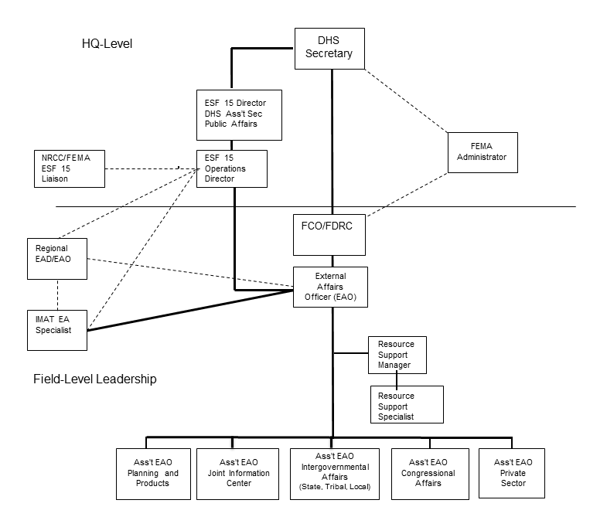
ESF 15 Organization Chart

Slide 15
External Affairs Officer
Appointed by the ESF 15 Operations Director (FEMA’s External Affairs Director for Stafford Act declarations) as the ESF 15 lead in the field
Manages deployed EA resources
Establishes strategies with state, local, tribal and territorial counterparts to meet incident objectives
Oversees ESF 15 functions, ensuring internal coordination and a unity of effort and messaging to engage external stakeholders.

Slide 16
ESF 15 Components
Joint Information Center
Congressional Affairs
Intergovernmental Affairs
Private Sector
Planning & Products

Slide 17
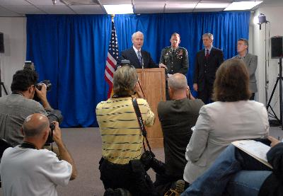
Joint Information Center
Central point for public affairs activities and media access to information regarding the response
Manages press conferences and briefings
Manages social media monitoring and outreach
Conducts media interviews, manages news desk, develops media analysis
Notes:
Coordination of federal, state, local, tribal and territorial and private sector incident communications

Slide 18
Congressional Affairs
Coordinates the exchange of information between DHS/FEMA, Members of Congress and their staff
Serves as primary contact for Congressional district offices on disaster response issues. Educates and provides updates to staff
Responds to Congressional inquiries and casework, tracks issues and trends
Arranges for Congressional site visits
Develops Congressional Affairs outreach plan in support of the response Incident Action Plan and the FCO’s objectives

Slide 19
Intergovernmental Affairs
Establishes effective working relationships with state, tribal territorial and local officials
Creates and maintains open, two-way lines of communication between these groups and the coordinated Federal response
Tribal Affairs-acts as conduit to/from the tribe. Serve as advisor and educator to JFO staff on cultural sensitivities and customs.
Notes:
Federally Recognized Tribes, Tribal Leadership and Communities
Tribal leadership is an essential part of our nation’s emergency management team. Consistent with our strong government to government relationship, FEMA, DHS and the Administration are committed to supporting Indian Country in their efforts to build more resilient and better prepared communities.
On Tuesday, January 29, 2013, President Obama signed the Sandy Recovery Improvement Act of 2013 -- a clear demonstration of the importance that Tribal Leadership and their governments are to our nation. The Sandy Recovery Improvement Act of 2013 amended the Stafford Act to provide Federally recognized Tribal governments the option to choose whether to make a request directly to the President for a federal emergency or major disaster declaration, or to seek assistance, as they do presently, under a declaration for a State.
Fully implementing this historic provision will require consultation with Tribes and other stakeholders. FEMA will develop the administrative and programmatic requirements and procedures necessary to execute the law. FEMA is fully committed to the prompt and collaborative development of appropriate regulations and policies for implementation.
At FEMA we believe that the provision to amend the Stafford Act under the Sandy Recovery Improvement Act of 2013:
Properly acknowledges the sovereignty of Federally recognized Indian Tribes and the government to government relationship with the United States;
Enhances FEMA’s working relationship with Tribal governments, and will ultimately enhance the preparedness of those governments;
Allows consideration for a Stafford Act declaration based on impacts within the Tribal government’s jurisdiction, regardless of the level of impact to the State(s) in which the tribe is located;
Eliminates the hardships some Tribal governments have experienced because of legal or other impediments that inhibited Tribal governments from going through the State to obtain federal disaster assistance; and
Allows for fair and consistent consideration for assistance across Tribal nations, including those Tribes where geographic boundaries cross multiple states.

Slide 20
Private Sector
Establishes and maintains contact with private-sector networks, major employers, and universities in impacted areas by providing response and recovery information.
Engages in information-sharing with private sector partners to increase situational awareness through:
Situational updates on evacuation routes/PODs;
Providing guidance on federal resources available to impacted employees;
Sharing information on operational disruptions (USPS, utilities, etc.);
Providing instructions on how to volunteer and donate appropriately; and
Providing business opportunities to recover by working with the government.
Notes:
Utilize the private sector for information distribution:
Internal comms systems to reach large populations
Leverage established networks (chambers, economic development councils, professional associations)

Slide 21
Planning & Products
Central point for development of internal and external products
Through unity of effort, centrally develops all strategic messaging to all stakeholders for response
House program liaisons that provide a coordinated communication link to key program areas
Notes:
Make note about how P&P: Liaisons work with DSAT (formerly CR) on community outreach issues and ground truth

Slide 22
ESF 15 Interagency Coordination Mechanisms
Staffing:
National/Regional Response Coordination Centers
National Joint Information Center (in DC)
Joint Field Office (at response location)
ESF 15 Mission Assignments
MAs for EA staff to support messaging on agency operations
MAs for EA staff to support general ESF 15 operations (i.e. Combat Camera, JPASE, CAISE)
Notes:
Two types of mission assignments

Slide 23
ESF 15 Interagency Coordination Mechanisms
Coordination Calls (NICCL, SICCL, PICCL)
Products
ESF 15 Daily Communications Summaries
Incident talking points and operational updates; stakeholder outreach; links to related interagency products; joint daily events schedule to de-conflict activities (i.e. congressional briefings, agency press conferences)
Battle Rhythm
External products on Federal Response Actions

Slide 24
Crisis Communications
At the end of the day, we want to get a message to people in a way that helps them actually take meaningful action during a crisis.
Notes:
Research has shown that during a serious crisis, affected people:
Take in information differently
Process information differently
Act on information differently

Slide 25
What changes during a crisis?
Initial information carries most weight
We simplify information
We embrace previously held beliefs
We look to people we trust to verify information
Risk perception influences our decision-making
Notes:
Public’s decision-making is different during an incident
Initial information carries most weight
In the absence of information, people fill in the blanks.
The first message is often the accepted one, even though more accurate info may follow
When they get new info, they compare it to what they’ve already heard.
We simplify: Primitive survival instincts kick in
People do not fully hear information or they may confuse action messages.
Embrace previously held beliefs
People reject actions that feel counterintuitive, such as evacuating when the weather appears calm.
We look to people we trust to verify information
Perceptions about risks influence our decision
Our responsibility is to deliver public information even if the news is bad
People can handle the truth as long as the information is timely, clear and consistent
Attempts to “manage” or disprove bad news almost always backfires
Reassurance is an outcome of successful policy, operations, and
communications performance working in unison not an objective to be solely achieved through messages.

Slide 26
What do we do?
Be first, be right, be credible
Express Sympathy
Promote Action
Show Respect
Notes:
BE FIRST: Crises are time-sensitive
BE RIGHT: Accuracy establishes credibility. Information should include what is known, what is not known, and what is bring done to fill in the information gaps.
BE CREDIBLE: Honesty and truthfulness should not be compromised.
Express Sympathy:
Harm and suffering should be acknowledged in words.
Address people’s feelings and the challenges they face.
Express empathy early or risk losing your audience.
Use phrases like, “I share your concern,” or “I understand how frightened you must be.”
Promote Action: Give people constructive and meaningful actions to calm anxiety and promote a sense of control.
Show Respect: Be respectful of others’ emotions and coping mechanisms.
Do not attempt to interject humor.
Respectful communication promotes cooperation and rapport.

Slide 27
ESF 15 Case Study:
Typhoon Soudelor

Slide 28
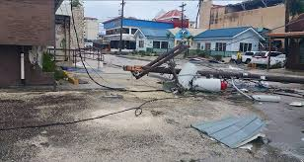
Typhoon Soudelor: Overview
Made landfall on the Commonwealth of Northern Mariana Islands (CNMI) on August 1, 2015
Hundreds of homes destroyed or damaged
Downed trees and power lines
No power, water, or waste services
9 shelters open with more than 600 people (above capacity)
Airport open day only; seaport closed

Slide 29
Typhoon Soudelor: Overview
President Obama declared major disaster on August 5.
Activated FEMA’s Individual Assistance and Public Assistance grant programs
FEMA mission assigned other federal agencies to support response:
U.S. Army Corps of Engineers: power restoration
USS Ashland and 31st MEU: generators and water
Environmental Protection Agency: SMEs on water quality and HAZMAT
Department of Energy: power restoration

Slide 30
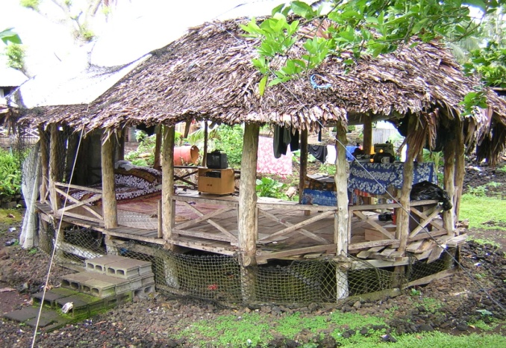
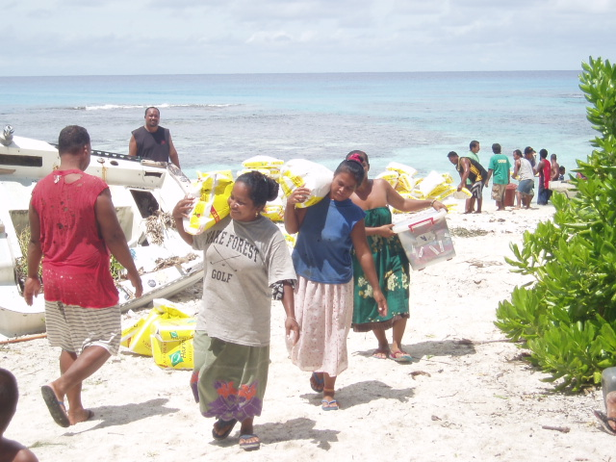
Challenges of Response and Recovery
Cultural and language differences
Limited technology and digital connectivity
Lack of infrastructure
Time and distance constraints
Distribution and re-supply capability
Local needs differ from mainland U.S. requirements and plans

Slide 31
Typhoon Soudelor Force Laydown-8/7/15

Slide 32
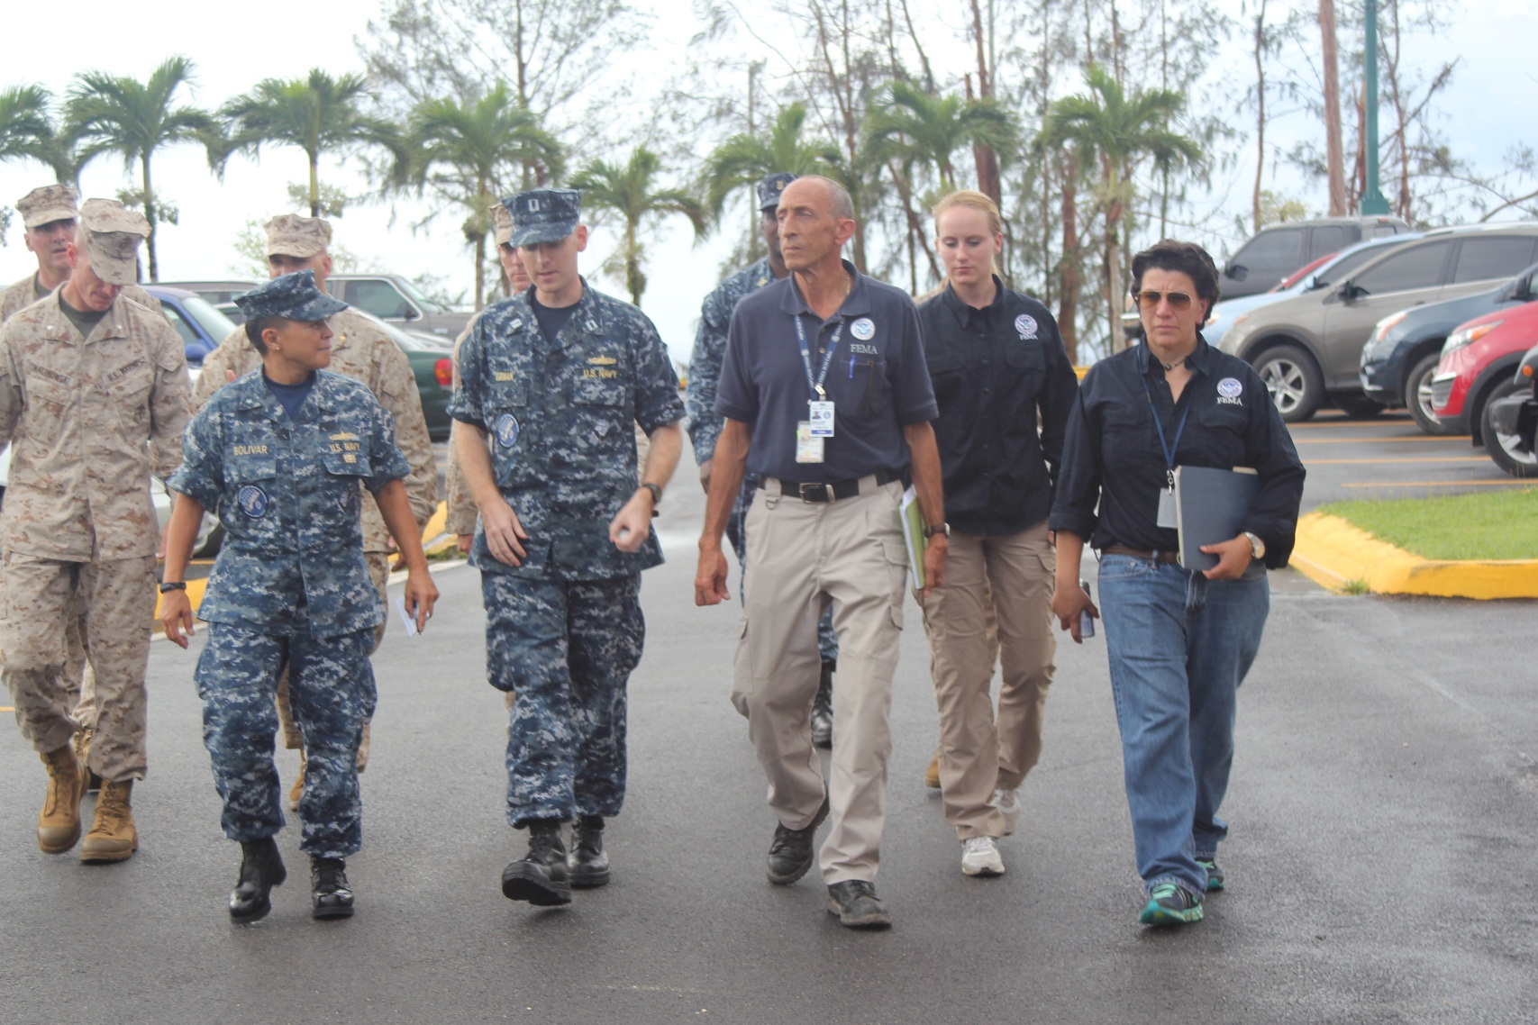
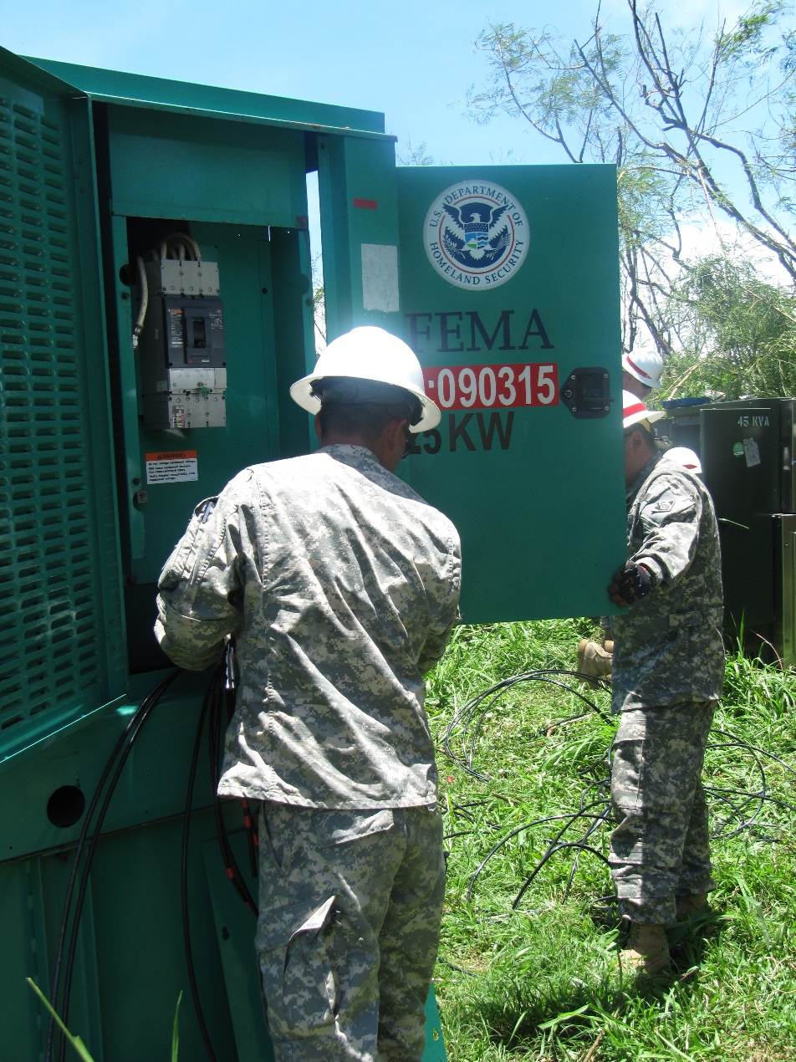
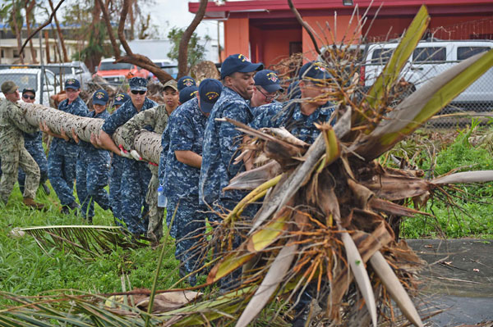

Slide 33
ESF 15 External Affairs Staffing
Local Partners:
CNMI JIC Staff
Guam JIC Staff (providing SME experience to Saipan)
FEMA EA Staff: EAO, P&P, Congressional Affairs, JIC, Private Sector Staff
OFA Partners:
31st MEU PAO
Commander, Naval Forces Marianas PAO
SBA, USACE, and ARC Reps

Slide 34
External Affairs Priorities and Challenges
Messaging Priorities
Life-saving/life-sustaining information (sheltering, water, mold/HAZMAT)
Rumor Control
Accurate, timely information on available resources (ARC, USMC, local agencies)
Messages accessible to whole community
Challenges
Limited media outlets
Lack of preliminary damage assessments, unsure of hardest hit demographics
Combating rumors
Notes:
Saipan is a small island community with about 50K people. Main sources of info on the island are radio, social media (facebook), 2 print newspapers, and word of mouth. A few weeks prior to the typhoon, the fiber optic cable bringing TV to the island was cut, so during the response there were no TV broadcast capabilities.

Slide 35
Leveraging Partnerships
Media
Radio-access to community, Q&A
Hosts became partners to shut down rumors and manage expectations
Local government
Outreach to Carolinian population
Private Sector
Bank workarounds to get funding to eligible minors
Notes:
As we discussed, people trust information from individuals in their community that they have an existing relationship with.

Slide 36
Social Media Outreach
CNMI JIC Facebook Page—developed for response. Managed by CNMI PIOs, co-located with FEMA EA to collaborate quickly on hot issues.
Interactive platform: respond to concerns from the public (Housing inspector example)
Great way to distribute informational flyers
Disseminate emergency shelter information for continuing severe weather
Notes:
Saipan is a small island community with about 50K people. Main sources of info on the island are radio, social media (facebook), 2 print newspapers, and word of mouth. A few weeks prior to the typhoon, the fiber optic cable bringing TV to the island was cut, so during the response there were no TV broadcast capabilities.

